Slide 1
CDISC 360i in Action: Demonstrating the Shift to Fully Digital Standards
Darren Moreland, CDISC Julie Smiley, CDISC
Bhavin Busa, Clymb Clinical
Peter Van Reusel, CDISC

Slide 2















360i Phase 1
Machine Executable Specifications
Schedule of Activities
Data Collection
Study Team
Build
Tabulation
Data Sources
Analysis
USDM
Protocol Outline
Design
Select Biomedical Concepts
Select Endpoints
eDT
Study Definitions
Company Configured Library
Data Standards
Data Collection
Data Transfer
Tabulation/Analysis
More Use Cases…
Biomedical Concepts Analysis Concepts Foundational Standards
Reference Specifications
EDC
EHR
Analyze
Output
Tabulation
Data
Analysis
Data
Results
TFLs
Report
DHT
Data Monitoring
Operational Data Store
Analysis, Interactive review, Other Use Cases
Run
Notes:
Now let’s take a look at where we’re going.
Starting with the digital protocol, study definitions are stored in USDM, supplemented by biomedical concepts to add meaning to the content.
Dataset specializations are pre-configured standards based on biomedical concepts (or BCs) that can be used to generate study artifacts like CDASH CRFs or SDTM Define-XML
The study definitions are then used programmatically to build machine executable specifications.
The specifications are used to build out standardized data collection, tabulation, and analysis artifacts.
Data is collected and transferred or retrieved, then programmatically converted into these standard artifacts using the specifications.

Slide 3

360i Phase 1
Machine Executable Specifications
Schedule of Activities
Data Collection
Study Team
Build
Tabulation
Data Sources
Analysis
USDM
Protocol Outline
Design
Select Biomedical Concepts
Select Endpoints
eDT
Study Definitions
Company Configured Library
Data Standards
Data Collection
Data Transfer
Tabulation/Analysis
More Use Cases…
Biomedical Concepts Analysis Concepts Foundational Standards
Reference Specifications
EDC
EHR
Analyze
Output
Tabulation
Data
Analysis
Data
Results
TFLs
Report
DHT
Data Monitoring
Phase 2 pre-work includes defining Analysis Concepts
Operational Data Store
Analysis, Interactive review, Other Use Cases
Run
Notes:
We just completed Phase 1, which focused on digital protocol through SDTM dataset generation
This year we will continue the path through analysis and submission in Phase 2, although some pre-work on defining analysis concepts has already started.

Slide 4
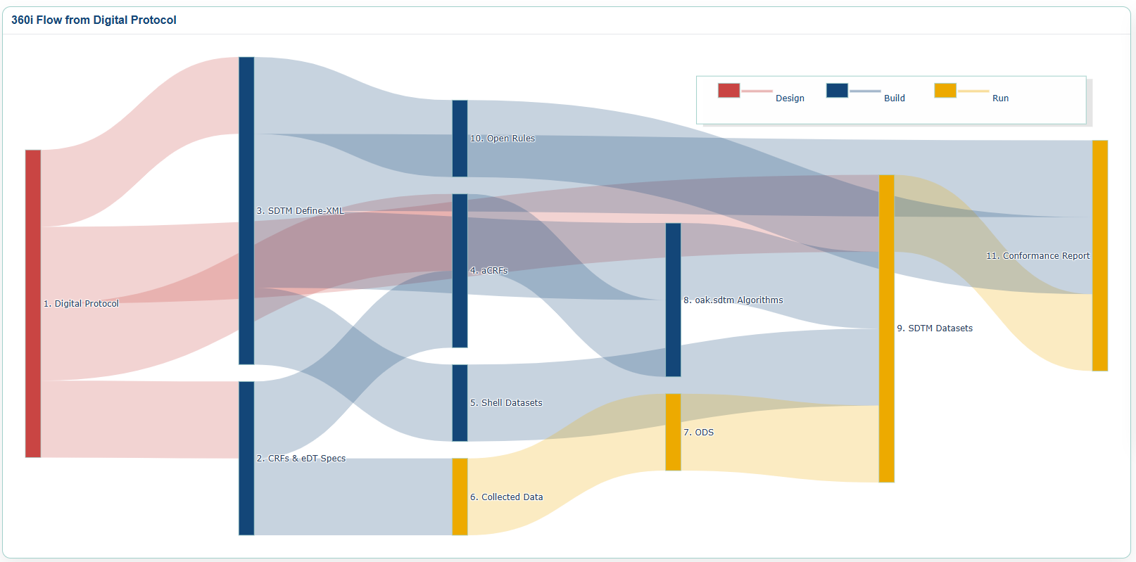
10. Open Rules
3. SDTM Define.xml
11. Conformance Report
4. aCRFs
1. Digital Protocol
8. oak: sdtm Algorithms
9. SDTM Datasets
5. Shell Datasets
7. ODS
2. CRFs &eDT Specs
6. Collected Data

Slide 5
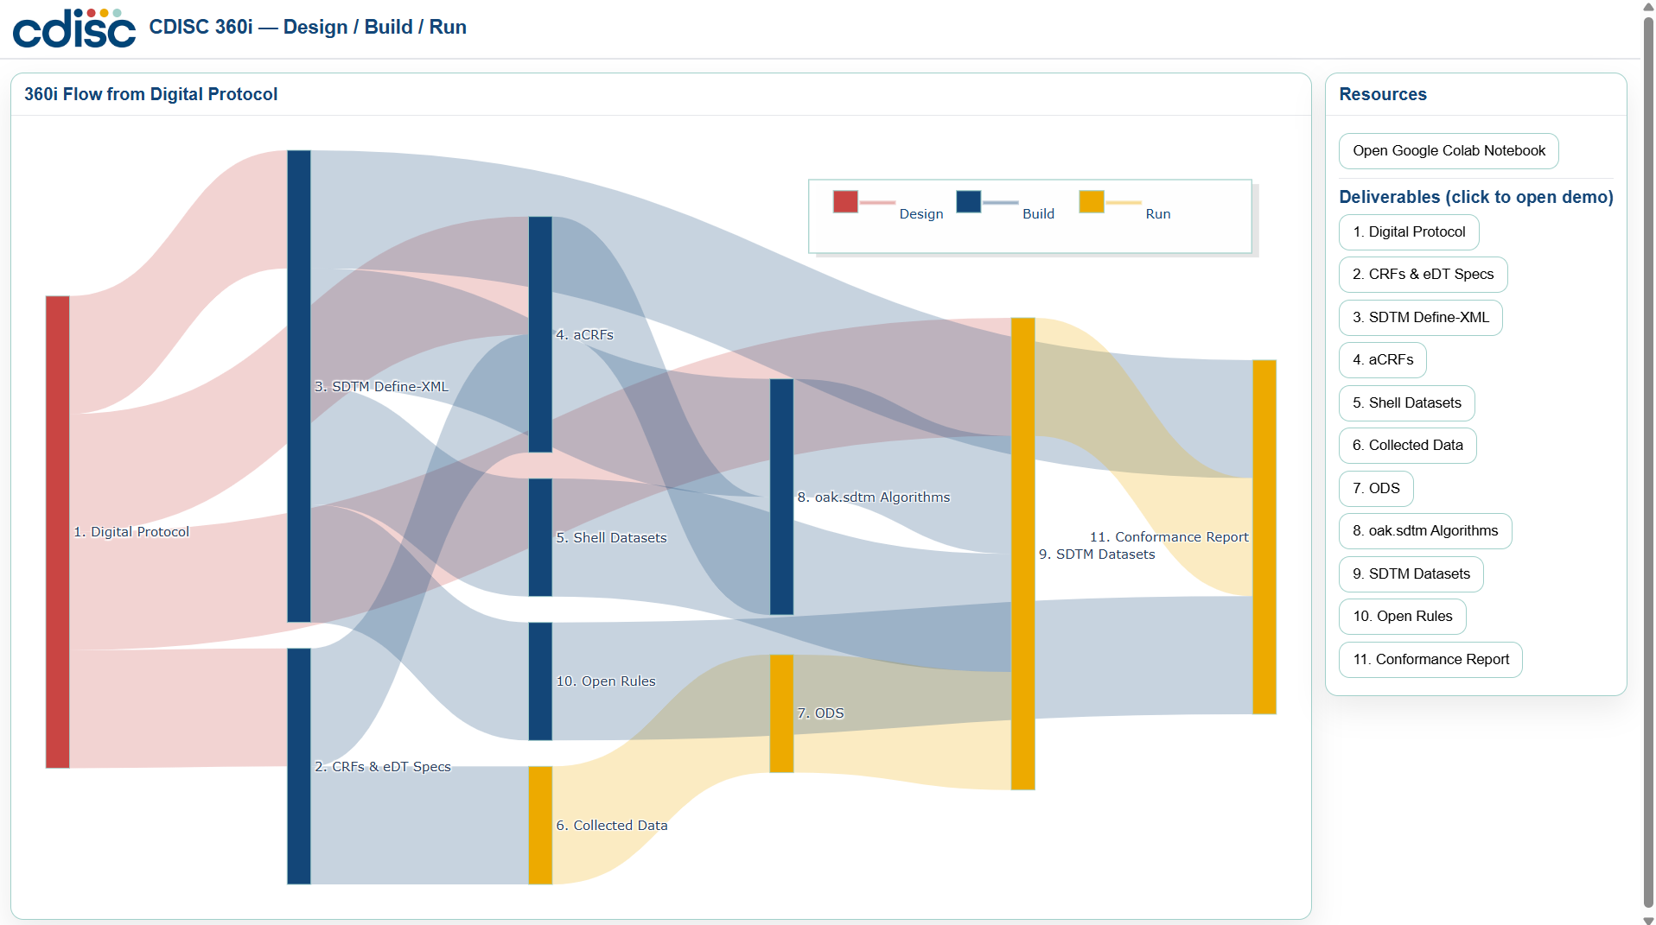
CDISC 360i Demos
Direct Video Links:
Digital Protocol
CRFs & eDT Specs
SDTM Define-XML
aCRFs
Shell Datasets
Collected Data
ODS
oak.sdtm Algorithms
SDTM Datasets
Open Rules
Conformance Report
Download diagram to access the notebook and videos
Click the link
File > Download

Slide 6
Demonstration Video

Slide 7
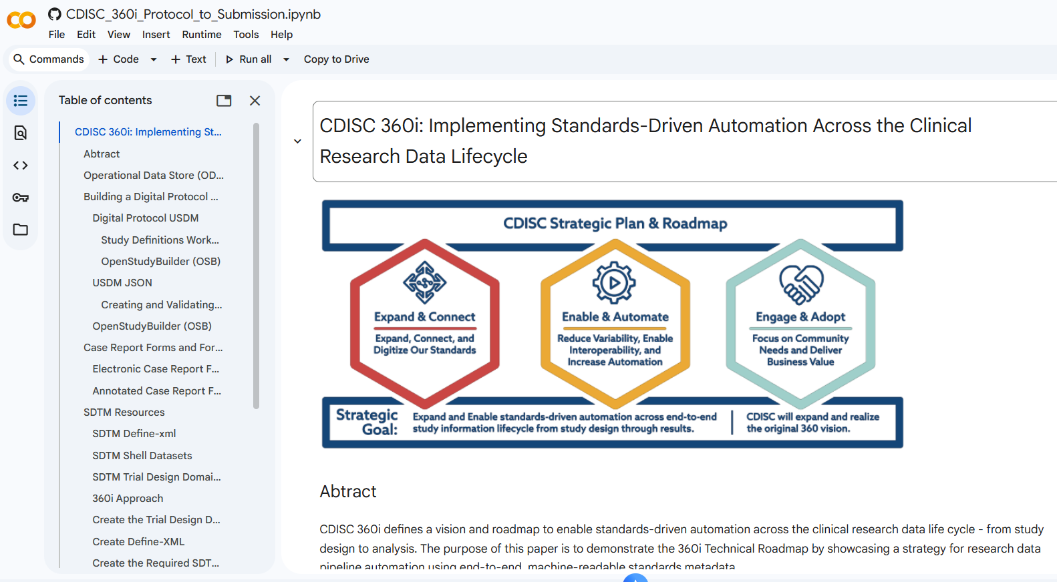
Google Colab Notebook

Slide 8
Accessing the 360i Notebook
The notebook displayed during this demonstration can be found here:
https://github.com/cdisc-org/cdisc-360i-notebooks
The repository is under continued development; follow repository for latest releases
There are multiple notebooks
Raise any issues encountered while using notebooks
To contribute to the CDISC project:
Fork the repo and create a new branch
Once changes are made and tested, raise a Pull Request
Notes:
And here is the link to the 360i GitHub repo we just looked at with the Google Colab notebooks

Slide 9
GitHub Repositories Used in the Demo
Purpose | Location
Study Definition Workbench | https://github.com/data4knowledge/study_definitions_workbench
Open Study Builder | https://gitlab.com/Novo-Nordisk/nn-public/openstudybuilder/OpenStudyBuilder-Solution
Study USDM documents | https://github.com/cdisc-org/360i/tree/main/data/protocol/LZZT/usdm
USDM validation utility | https://github.com/pendingintent/cdisc-json-validation
CDISC CORE Rules Engine | https://github.com/cdisc-org/cdisc-rules-engine
CRF creation | https://github.com/lexjansen/cdisc360i-pocs
Trial Design Dataset creation | https://github.com/pendingintent/cdisc-usdm-utils
Define-XML template creation | https://github.com/dostiep/360i
Define-XML creation | https://github.com/swhume/template2define
Raw subject data | https://github.com/alidootson/UpdatedCDISCPilotData/tree/main/UpdatedCDISCPilotData/CDASH
Notes:
Here is a list of the different GitHub Repos used in the demo

Slide 10
Using GitHub
The GitHub repositories used in the demo are public and use open-source libraries
The process for using these libraries is consistent:
Fork the original public repository into personal GitHub repository
Create new branch in personal GitHub repository
Edit code to meet individual requirements, add features or fix issues
Commit changes to personal branch
If proposing change to parent (original) branch to share with wider community:
Raise a Pull Request with original repository owner
Original repository owner will review the Pull Request and work with requestor to evaluate and test Pull Request
Merge new code in Pull Request with original parent branch
Notes:
Again, these repos are all public and use open source libraries. Here is a quick overview on how to utilize these libraries

Slide 11
Thank You!

